Slide 1

ICT PROJECT
PHOTO Manipulation

Slide 2
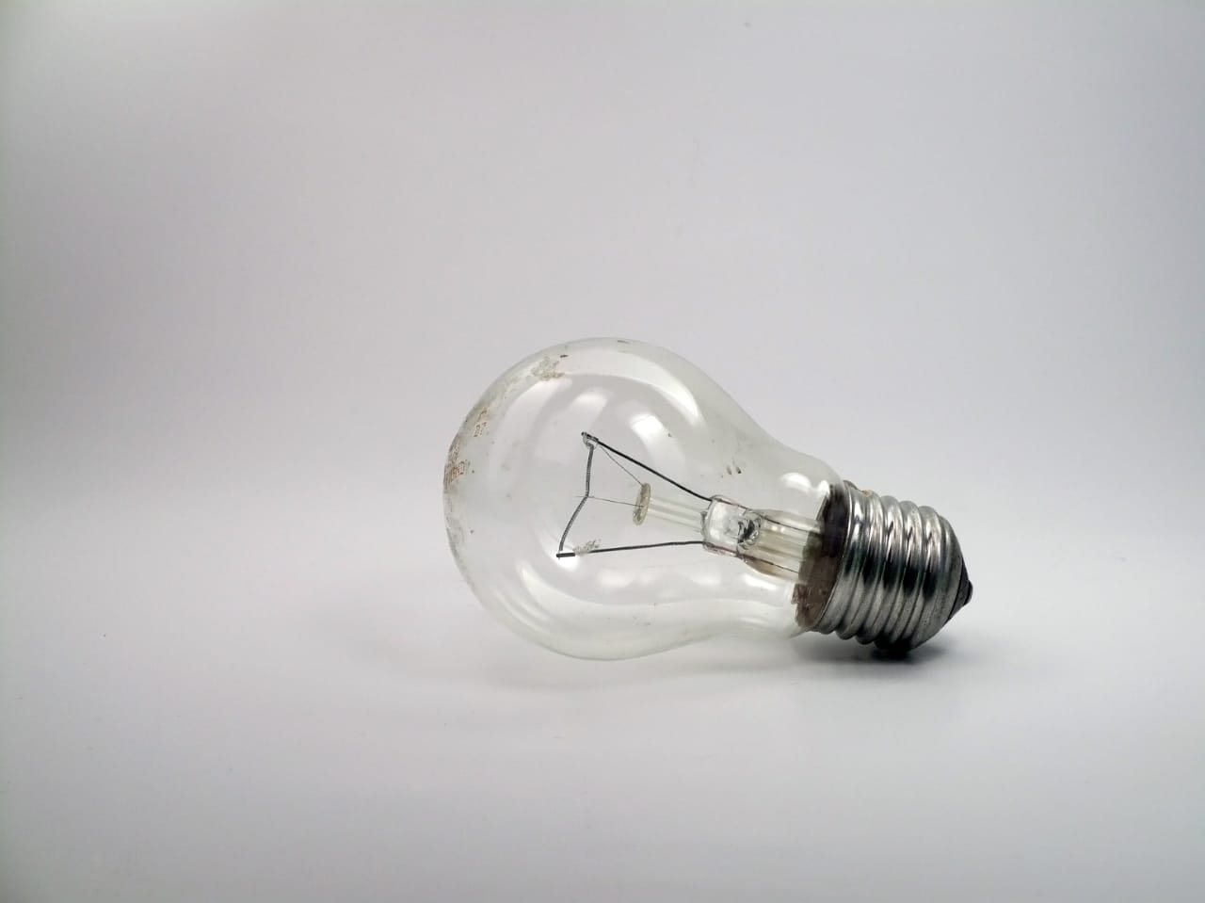
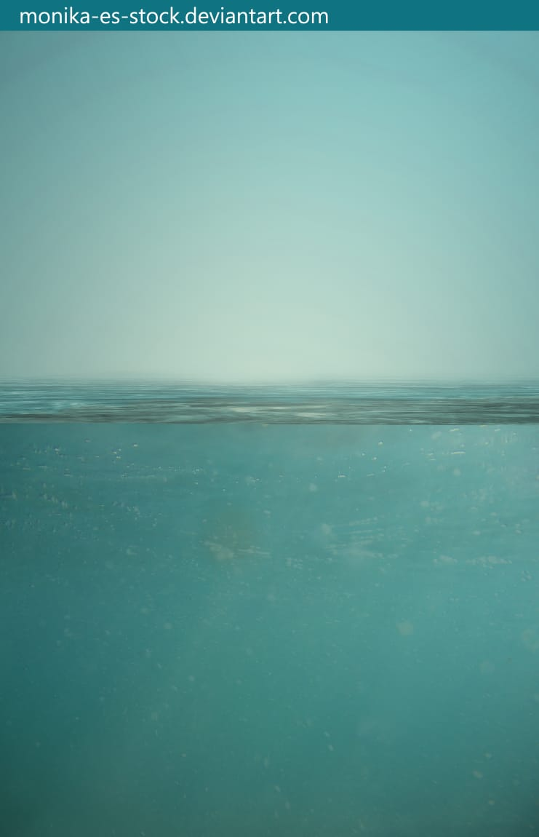
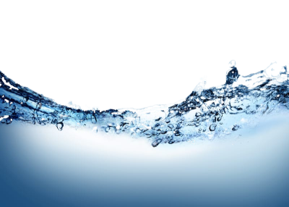
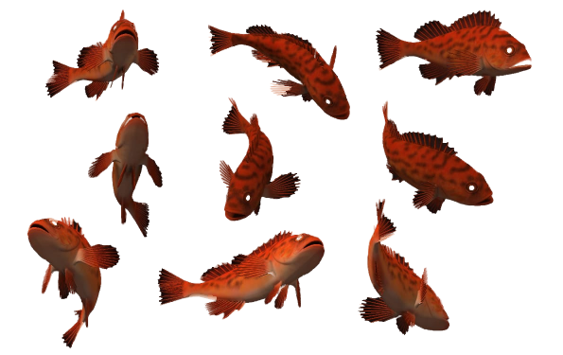
Images to be Used
Bulb
Water
Splash
Fish

Slide 3
Working;
Insert Bulb Image
First we insert the bulb image form file option and make the copy of it with [Ctrl + J]. After inserting bulb image we cut the unnecessary area from the middle of the bulb cut it carefully by using ( Lasso Tool ). Select the area you want to cut than press right click select Fill option and than Content-Aware option. Do it in steps now the bulb is ready and we have to as some shadow to do that we have to select Elliptical Marquee Tool. Make sure your colour is black and set opacity around 30-40%. Now your shadow is ready and we have to add some water in it.

Slide 4
Add Water Image
Go to the file menu and select place and pic the water image and place it than zoom out little bit for proper view. Now go and change it’s blending mode to Multiply so you can see it clearly than put it so it covers the whole bulb and than confirm it. Now select the move option and adjust it as half of bulb is cover with water. Now we will remove unnecessary area so first click on Layer Mask and than go to select Brush Tool make sure your hardness is 0%, opacity is 100% and colour is black. Now erase it carefully you can make your brush smaller and bigger by using [ ] keys keep making smaller and bigger. When you came really near to bulb Zoom in make your brush smaller and erase it carefully take your time don’t rush this thing and the biggest advantage of Brush Tool is that lets say you remove something from inside the bulb all you have to do just change the colour to white and than you change it back. After doing we have to add some colour so its look really good for that go to your adjustment layer and select Hue/Saturation. Now in Hue/Saturation first thing you do is turn on your Clipping Mask so it will only effect on your water layer after this you change your Hue at some where around 10-15%, increase the Saturation around 40-45% and increase the lightness around 12-19% so its bit brighter and looks really nice and than go and close it. Now we can add the fish.

Slide 5
Add Fish Image
Just like last time go to file menu and select place option now select the Fish Pic and place it. If it is very small hold your Shift Key and make it bigger. Big enough so we can have 2 Big Fish in the bulb than go and confirm it now go and confirm it. Than go and select the Lasso Tool and make the selection of Fish you want to add in it after that right click and click on Layer Via Copy and turn original Fish layer off and selected Fishes remain on the bulb rest will be cut-out. Now press [ Ctrl + T ] so it will select your Fish Layer make it smaller and bigger always hold shift key while making it Smaller and Bigger and rotate it little bit so it will properly fix in the bulb than go and confirm it. Now change the opacity of your Fish layer some where around 75-80% so its look really nice. Now our Fish and Water is completed and looks very nice and we will add Splash in it.

Slide 6
Add Splash Image
Place Splash image and just like last time hold shift key and make Splash smaller and bigger make it big enough so it will cover the bulb and than confirm it. Now go and change the blending mode to this layer to overlay and opacity around 80-90%. Now just like last time we remove unnecessary area, go to Layer Mask than select Brush Tool make sure its very Soft Brush, opacity is 100% and colour is black now go and remove it. Now to make it more colourful to do so I will go to Vibrance and in Vibrance I will set it around 50-60%. Now the final effect in the bulb is ready and we have to add some reflection for that you create a new blank layer than you press [ Ctrl + Alt + Shift + E ] so we have a copy of image than you press [ Ctrl + T ] right click and select Flip Vertical than you set it to make the reflection if you can’t see the image properly so you reduce some opacity now set it for giving a reflection than go and confirm it. Now go and set opacity around 20% so its looks very nice than we will confirm it. After this we remove the unnecessary area here you can use eraser make your eraser bigger and remove it from the unnecessary area make sure your eraser is very soft and that is it. This is the final out.

Slide 7
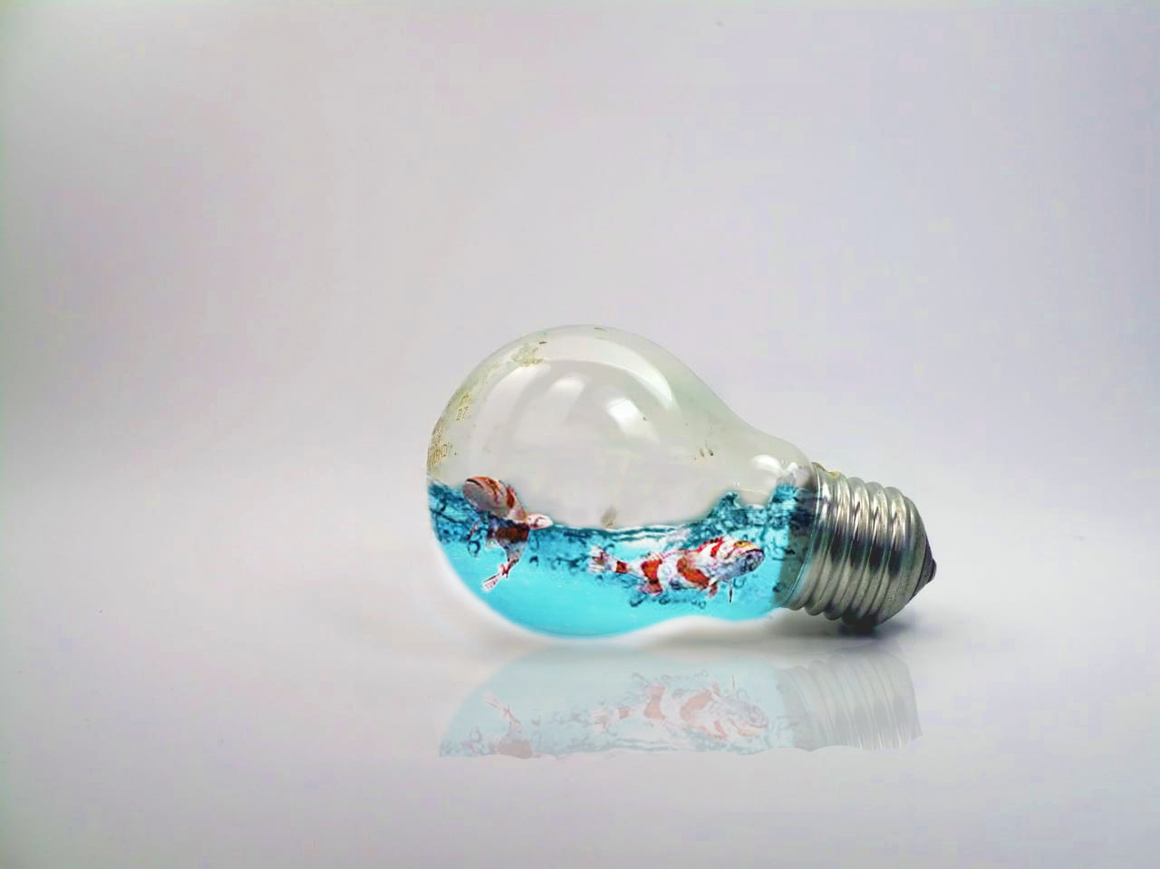
Final Output

Slide 8
Presented by;
Mohammad Usama 20K-0190
Rahib Hussain 20K-1623
Masab Bin Fakhar 20K-0123

